Slide 1
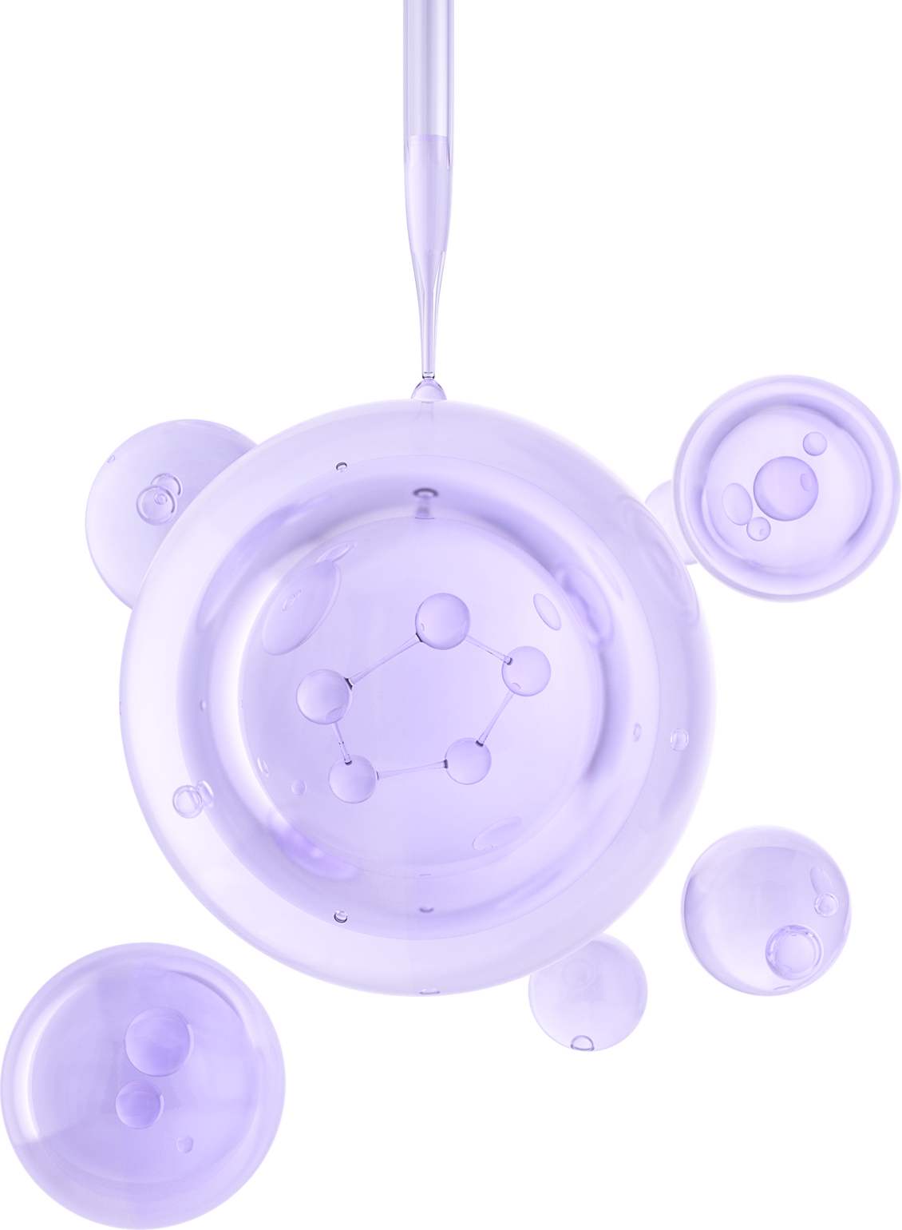

UNIVERSITY OF BASRAH / COLLEGE OF SCIENCE
SEPTEMBER 2023
LECTURE 1
BACTERIAL CLASSIFICATION AND NOMENCLATURE
Department of Pathological Analyses
Prof.Dr. Saad S. Mahdi Al-Amara

Slide 2
Classification of Bacteria in different 9 ways
1. Classification on the basis of Gram Stain and Bacterial Cell Wall
2. Classification of Bacteria on the Basis of Shape Others
3. Classification of Bacteria on the Basis of Mode of Nutrition
4. Classification of Bacteria on the Basis of Temperature Requirement
5. Classification of Bacteria on the Basis of Oxygen Requirement
6. Classification of Bacteria on the Basis of pH of Growth
7. Classification of Bacteria on the Basis of Osmotic Pressure Requirement
8. Classification of Bacteria on the Basis of Number of Flagella
9. Classification of Bacteria on the basis of Spore Formation

Slide 3
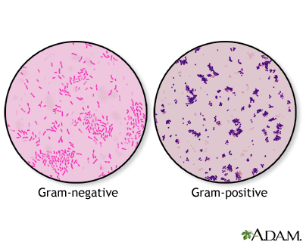
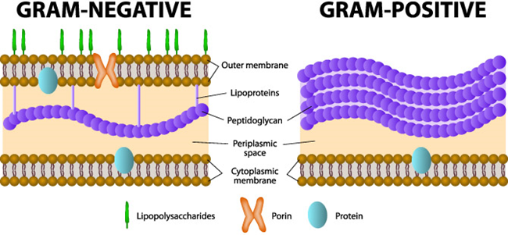
Classification on the basis of Gram Stain and Bacterial Cell Wall
  Gram stane
  Gram positive vs Gram negative cell wall
Of all the different classification systems, the Gram stain has withstood the test of time. Discovered by H.C. Gram in 1884 it remains an important and useful technique to this day. It allows a large proportion of clinically important bacteria to be classified as either Gram positive or negative based on their morphology and differential staining properties.
The difference between the two groups is believed to be due to a much larger peptidoglycan (cell wall) in Gram positives. As a result the iodine and crystal violet precipitate in the thickened cell wall and are not eluted by alcohol in contrast with the Gram negatives where the crystal violet is readily eluted from the bacteria.
Some bacteria such as mycobacteria are not reliably stained due to the large lipid content of the peptidoglycan. Alternative staining techniques (Kinyoun or acid fast stain)

Slide 4
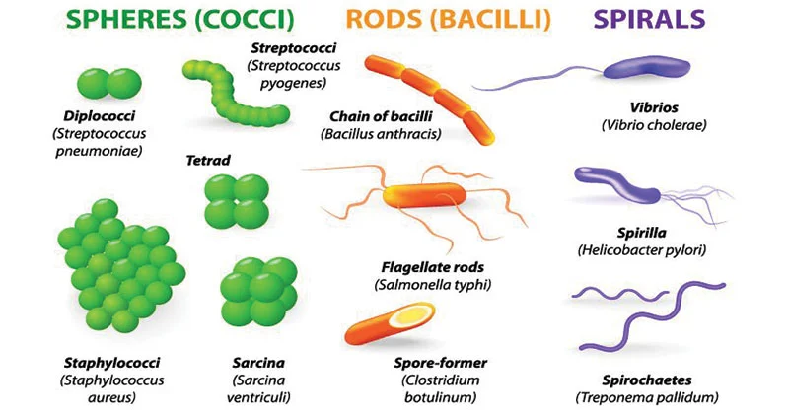
Classification of Bacteria on the Basis of Shape Others

Slide 5

Classification of Bacteria on the Basis of Mode of Nutrition
1`.Phototrophs:
  Those bacteria which gain energy from light.
  Phototrops are further divided into two groups on the basis of source of electron.
A.Photolithotrophs: these bacteria gain energy from light and uses reduced inorganic compounds such as H2S as electron source. Eg. Chromatium okenii.
B.Photoorganotrophs: these bacteria gain energy from light and uses organic compounds such as succinate as electron source.
2.Chemotrophs:
  Those bacteria gain energy from chemical compounds.
  They cannot carry out photosynthesis.
Chemotrops are further divided into two groups on the basis of source of electron.
A.Chemolithotrophs: they gain energy from oxidation of chemical compound and reduces inorganic compounds such as NH3 as electron source. Eg. Nitrosomonas.
B.Chemoorganotrophs: they gain energy from chemical compounds and uses organic compound such as glucose and amino acids as source of electron. eg. Pseudomonas pseudoflava.

Slide 6
Classification of Bacteria on the Basis of Mode of Nutrition
3.Autotrophs:
  Those bacteria which uses carbondioxide as sole source of carbon to prepare its own food.
  Autotrophs are divided into two types on the basis of energy utilized to assimilate carbondioxide. ie. Photoautotrophs and chemoautotrophs.
A.Photoautotrophs: they utilized light to assimilate CO2. They are further divided into two group on the basis of electron sources. 1. Photolithotropic autotrophs and 2.Photoorganotropic autotrophs
B.Chemoautotrophs: They utilize chemical energy for assimilation of CO2
4.Heterotrophs:
  Those bacteria which uses organic compound as carbon source.
  They lack the ability to fix CO2.
  Most of the human pathogenic bacteria are heterotropic in nature.
  Some heterotrops are simple, because they have simple nutritional requirement. However there are some bacteria that require special nutrients for their growth; known as fastidious heterotrophs.

Slide 7
Classification of Bacteria on the Basis of Temperature Requirement
1.Psychrophiles:
  Bacteria that can grow at 0°C or below but the optimum temperature of growth is 15 °C or below and maximum temperature is 20°C are called psychrophiles
Psychrophiles have polyunsaturated fatty acids in their cell membrane which gives fluid nature to the cell membrane even at lower temperature. Examples: vibrio marinus, Polaromonas vaculata, Psychroflexus.
2.Psychrotrops (facultative psychrophiles):
  Those bacteria that can grow even at 0°C but optimum temperature for growth is (20-30)°C
3.Mesophiles:
  Those bacteria that can grow best between (25-40)o C but optimum temperature for growth is 37C Most of the human pathogens are mesophilic in nature. Examples: E. coli, Salmonella, Klebsiella, Staphylococci.

Slide 8
Classification of Bacteria on the Basis of Temperature Requirement
4.Thermophiles:
  Those bacteria that can best grow above 45C.
  Thermophiles capable of growing in mesophilic range are called facultative thermophiles.
  True thermophiles are called as Stenothermophiles, they are obligate thermophiles,
  Thermophils contains saturated fattyacids in their cell membrane so their cell membrane does not become too fluid even at higher temperature.
  Examples: Streptococcus thermophiles, Bacillus stearothermophilus, Thermus aquaticus.
5.Hypethermophiles:
  Those bacteria that have optimum temperature of growth above 80C.
  Mostly Archeobacteria are hyperthermophiles.
  Monolayer cell membrane of Archeobacteria is more resistant to heat and they adopt to grow in higher remperature.
  Examples: Thermodesulfobacterium, Aquifex, Pyrolobus fumari, Thermotoga.

Slide 9
Classification of Bacteria on the Basis of Oxygen Requirement
1.Obligate Aerobes:
  Require oxygen to live. Example: Pseudomonas, common nosocomial pathogen.
2.Facultative Anaerobes:
  Can use oxygen, but can grow in its absence. They have complex set of enzymes.Examples: E. coli, Staphylococcus, yeasts, and many intestinal bacteria.
3.Obligate Anaerobes:
  Cannot use oxygen and are harmed by the presence of toxic forms of oxygen. Examples: Clostridium bacteria that cause tetanus and botulism.
4.Aerotolerant Anaerobes:
Cannot use oxygen, but tolerate its presence. Can break down toxic forms of oxygen. Example: Lactobacillus carries out fermentation regardless of oxygen presence.
5.Microaerophiles:
  Require oxygen, but at low concentrations. Sensitive to toxic forms of oxygen.Example: Campylobacter.

Slide 10
Classification of Bacteria on the Basis of pH of Growth
1.Acidophiles:
  These bacteria grow best at an acidic pH.
  The cytoplasm of these bacteria are acidic in nature.
  Some acidopiles are thermophilic in nature, such bacteria are called Thermoacidophiles.
  Examples: Thiobacillus thioxidans, Thiobacillus, ferroxidans, Thermoplasma, Sulfolobus .
2.Alkaliphiles:
  These bacteria grow best at an alkaline pH.
  Example: Vibrio cholerae optimum ph of growth is 8.2.
3.Neutrophiles:
  These bacteria grow best at neutral pH (6.5-7.5).
  Most of the bacteria grow at neutral pH.
  Example: E. coli

Slide 11
Classification of Bacteria on the Basis of Osmotic Pressure Requirement
1.Halophiles:
  Require moderate to large salt concentrations.
  Cell membrane of halophilic bacteria is made up of glycoprotein with high content of negatively charged glutamic acid and aspartic acids. So high concentration of Na+ ion concentration is required to shield the –ve charge.
  Ocean water contains 3.5% salt. Most such bacteria are present in the oceans.
  Archeobacteria, Halobacterium, Halococcus.
2.Extreme or Obligate Halophiles:
  Require a very high salt concentrations (20 to 30%).
  Bacteria in Dead Sea, brine vats.
3.Facultative Halophiles:
  Do not require high salt concentrations for growth, but tolerate upto 2% salt or more.

Slide 12
Classification of Bacteria on the Basis of Number of Flagella
On the basis of flagella the bacteria can be classified as:
1.Atrichos: These bacteria has no flagella. Example: Corynebacterium diptherae.
2.Monotrichous: One flagellum is attached to one end of the bacteria cell. Example: – Vibro cholerae.
3.Lophotrichous: Bunch of flagella is attached to one end of the bacteria cell. Example: Pseudomonas.
4.Amphitrichous: Bunch of flagella arising from both end of the bacteria cell. Example: Rhodospirillum rubrum.
5.Peritrichous : The flagella are evenly distributed surrounding the entire bacterial cell. Example: Bacillus.

Slide 13
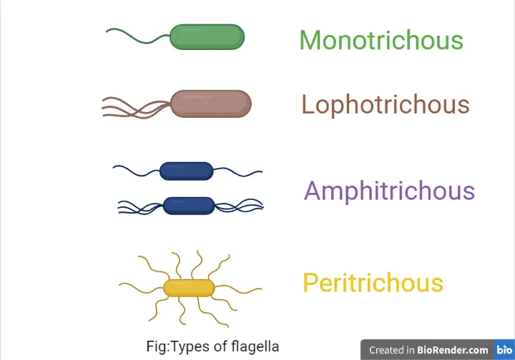

Slide 14
Classification of Bacteria on the basis of Spore Formation
1.Spore forming bacteria:
  Those bacteria that produce spore during unfavorable condition.
  These are further divided into two groups:
i) Endospore forming bacteria: Spore is produced within the bacterial cell.Examples. Bacillus, Clostridium, Sporosarcina etc
ii) Exospore forming bacteria: Spore is produced outside the cell.Example. Methylosinus
2.Non sporing bacteria:
Those bacteria which do not produce spores. Eg. E. coli, Salmonella.

Slide 15
THANK YOU

